Slide 1
Machine Learning approach towards Fake News Detection
November 24, 2020
Group 8

Slide 2
Introduction

Slide 3
Background What is news?
News can be defined as a broadcast or published report of information
News is the major source of information which is utilized by people to learn about the happenings of the world.
They are one of the largest methods of the dissemination of new information.
Online media makes information easier to spread and it causes more misinformation.

Slide 4
Background Why it matters?
The widespread reach of social media allows for the rapid dissemination of information.
The media is feeding us more and more information
Being able to distinguish misinformation protect us from being manipulated

Slide 5
Project objective:
The main objective of this project is to develop a trained machine learning model to help determine the validity of news articles.

Slide 6
Overall Approach
Preprocessing
Model Pipeline
Metrics
In this step, data was visualized on the various metrics possible such as Date, Subject Word Count.
Preprocessing of the data was performed to clean up and stem or lemm the data.
A set of machine learning pipelines were implemented as shown below
Countvectorizer
TFIDFtransformer
Machine learning Model
The following metrics were used to compare the the performance of the model
F1-SCORE,
Precision
Recall
AUC,
Mean accuracy
Notes:
Make a graph of the Dates of the data collection

Slide 7
Methods

Slide 8
Techniques and libraries used
The following machine learning models were utilized for the project
Random Forest
Ridge Classifier,
Logistic Regression
Nearest Neighbor
The following Metrics were used to evaluate the models
F1-score, precession, recall of the testing data.
Mean Accuracy of the training and Testing dataset
AUC of the testing data.

Slide 9
Techniques and libraries used
The following Libraries were utilized for this project.
Numpy,
Sklearn,
Matplotlib,
NLTK,
Panda

Slide 10
Preprocessing
Data visualization:
Histogram of the date and word count, Most common words, Subject
Text Processing:
Text cleanup of symbols,
Removal of stop words
Lemmatization and stemming of the processed data

Slide 11
Processing
In this step, a pipeline was developed to input the preprocessed data into machine learning models and determine the output.
Countvectorizer
TFIDFtransformer
Machine Learning model

Slide 12
Post Processing
Utilized the metrics mentioned above on the results of the prediction of the models.

Slide 13
Results

Slide 14
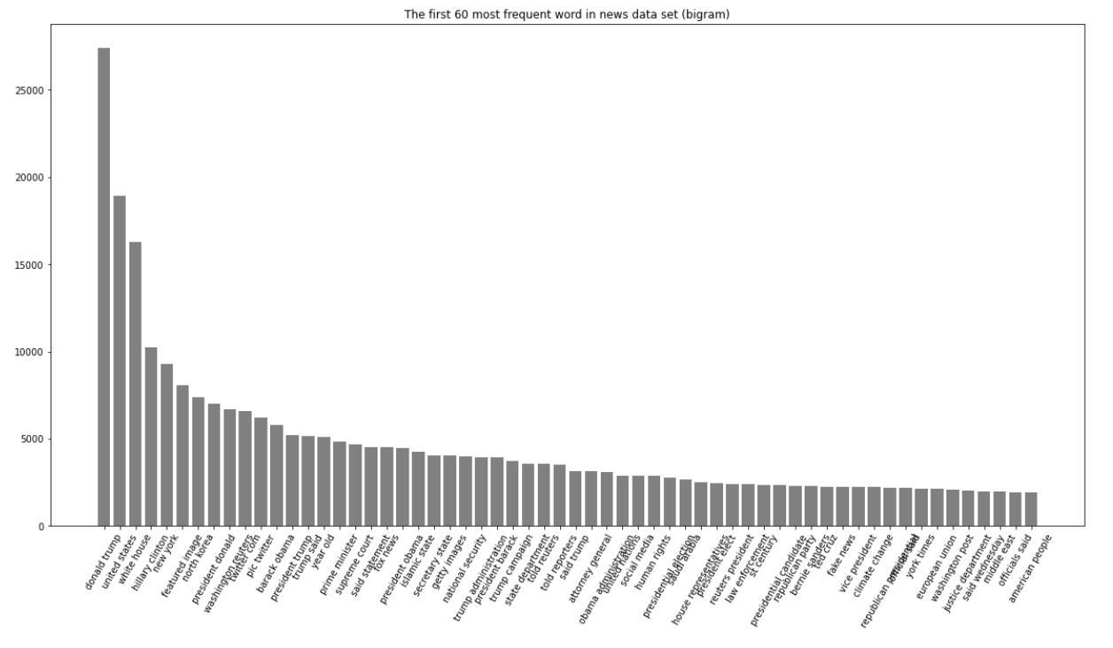
60 most frequent word(bigram)

Slide 15
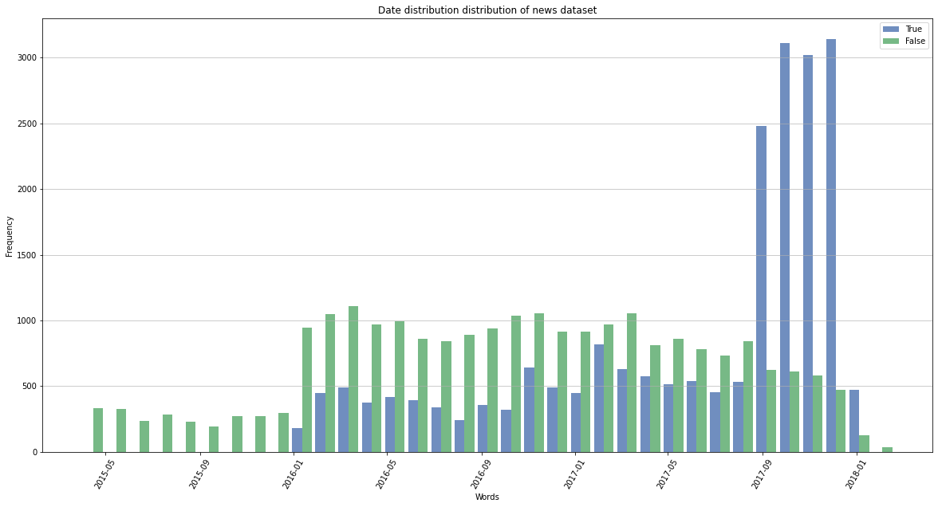
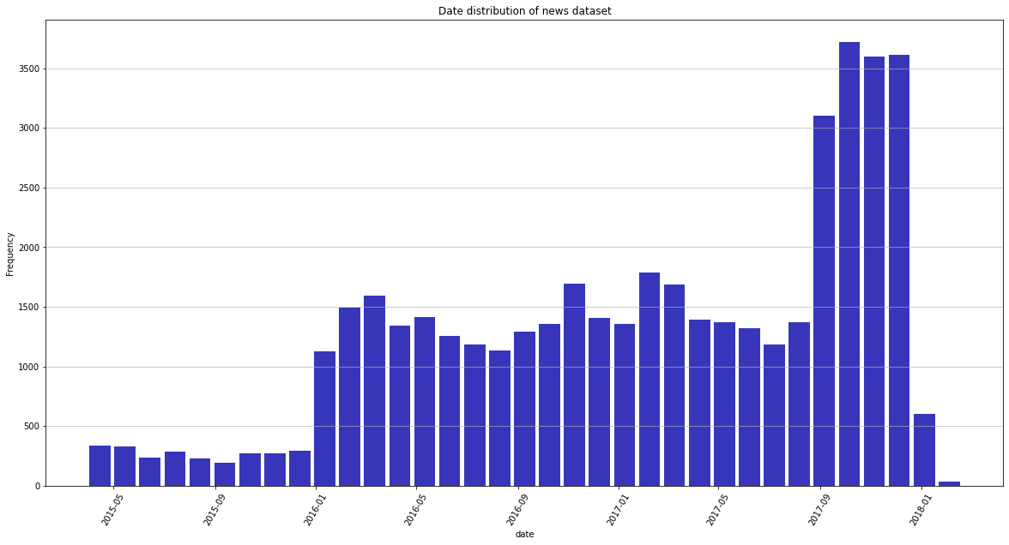
Histogram of the Date

Slide 16
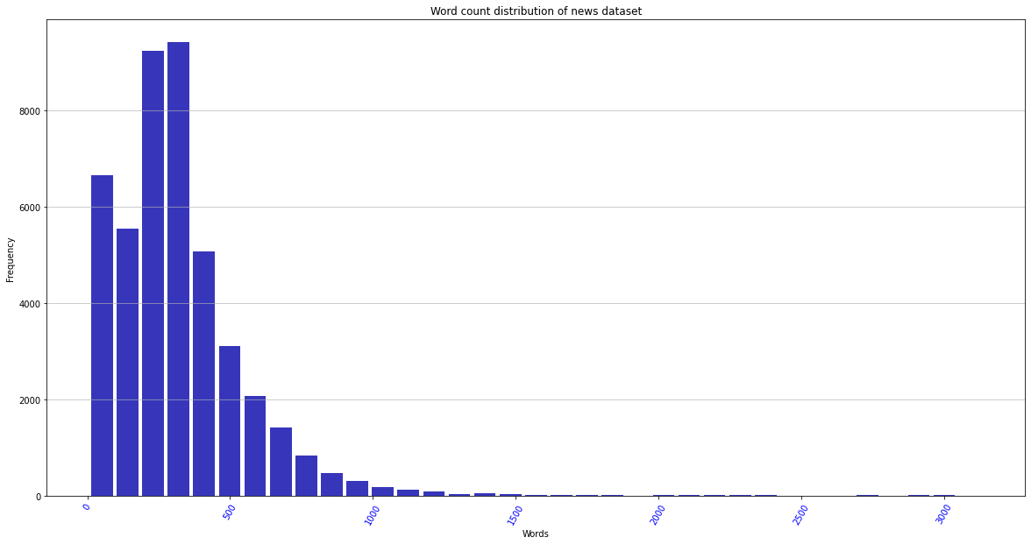
Histogram of the Word Count

Slide 17
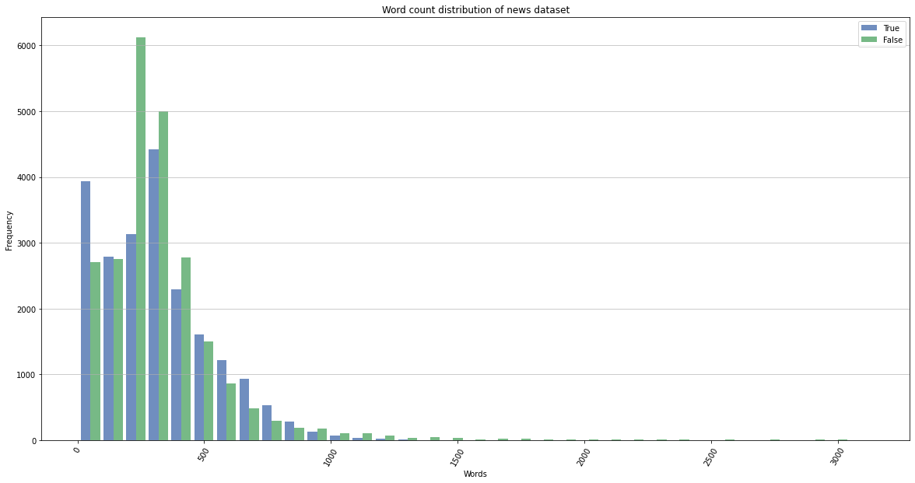
Histogram of the Word Count

Slide 18
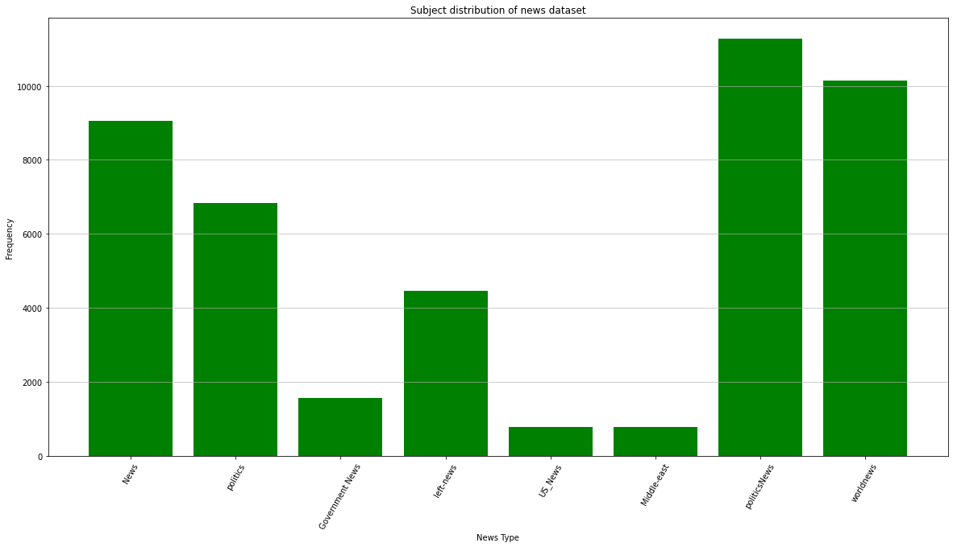
Bar Graph of the Subject distribution

Slide 19
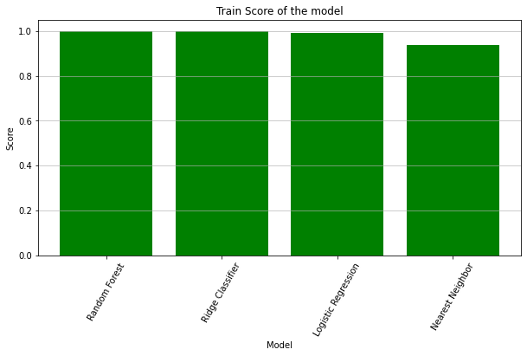
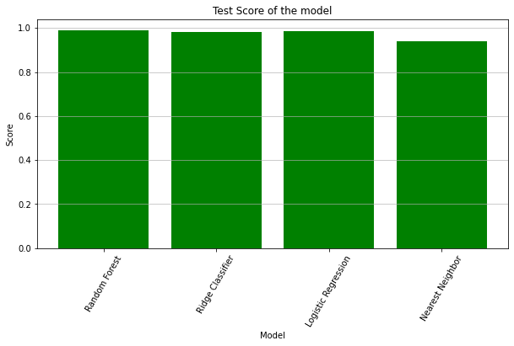
Results: train score, test score

Slide 20


Results: F1 Score, AUC

Slide 21
Discussion and Conclusion

Slide 22
Discussions
The results showed that the models performed well on the dataset provided
To further test the model, data with better quality is required
Bias in the data:
Data collection
Labelings of the data
Time-sensitive model

Slide 23
Discussion continued
Problems faced:
GridsearchCV required reduction in the parameters tested in collaboration with the pipeline
The default CV resulted in incredibly long times without significant improvement and thus a reduction in the CV was required.
Issues with parallel usage which where the worker stopped.
Future direction:
A more generalized model with a larger dataset
A separate model that keeps track of the trends and updates the classification model

Slide 24
Conclusion
The models showed the ability to accurately identify the news based on the evaluation on the testing data set.
Ideally, the random forest model will be utilized
To more accurately assess the model, better labeled data with bias reduction from a variety of sources and a larger time frame is required to be train as well as tested on.

Slide 25
Questions?

